Slide 1
INFO 6350
Mobile Wireless Computing/Smartphones-Based Web Development

Slide 2
Mobile Architecture
Mobile architecture is the pieces of technology needed to create a rich, connected user experience. It allows maintaining the connection of computers/devices even if they are disconnected from their internal network or being moved around.(i.e. Send/Receive data without being connected to a fixed physical link )

Slide 3
Other terms:
Mobile Computing
Mobile Computing Technology
All refer to a generic term that is related to technologies that allow a user to take his computer/device with him and to use it without being connected to a physical link.

Slide 4
Mobile Technologies include:
Mobile Computers
  Computers or similar devices such as notebooks, Personal Digital Assistants (PDA), mobile phones
Remote Connections
  Use your computer from remote locations. Cloud computing – Virtual Private Network (VPN) access.
Desktop Virtualization
  Using software, you can recreate your computing experience on any available hardware. Client-hosted or centralized on servers in the data center - VDI

Slide 5
Why Mobile?
Reach a target audience in a timely and effective manner, at the point in time that is most relevant to them.
• Reach your target any time, anywhere - rather than just when they are at their computer or TV.
Great way to create an ongoing dialog with the audience as it encourages an interactive response from the target audience.
Create a low-cost marketing and high-impact
Quick and easy to deploy.

Slide 6
Characteristics of a Mobile Architecture
Scalability – A Mobile Architecture must be able to be utilized with all recovery requirements on both large and small scale.
Security – Should deal with authentication, information integrity, and identification problems. Encryption is often used. Transmission protocols must support encryption (Secure Sockets Layer - SSL) via secure transit such as HTTPS.
Reliability – (fault- tolerance) Reliability is always important in all technologies and Mobile Architecture is no different – On-going research and existing frameworks for analyzing reliability in mobile computing domains.

Slide 7
Future of Mobile Architecture
More exciting products and services that are based on open, global standards.
Protocols and interfaces are not locked to proprietary technologies
The architecture framework and service enablers will be independent of Operating Systems (OS).
Provide an acceptable power consumption

Slide 8
Open Architectures?
An open approach is required across all industries to achieve same end results and services.
But the lack of a uniform interoperability plan:
  Often increases costs
  Slows down mobile development.

Slide 9
Existing Architectures
Secure Mobile Architecture (SMA)
  Presented at the Open Group Conference in Berlin, April 2001
  Published in February 2004.
  The architecture described in the SMA Vision and Architecture was developed by Boeing, Lockheed-Martin, Motorola, IBM, Hewlett-Packard, NetmotionWireless, and the University of St Thomas.
  Based on:
      Host Identity Protocol (HIP) – ID in every packet
      Cryptographic identities using Public key infrastructure (PKI)
      secure directories- info about user, owner, machine etc…
      location of user/device

Slide 10
Manet( Mobile ad-hoc network)
Mobile mesh network
Each device is free to move independently
Each device must be a router and forward traffic unrelated to its own use.
Can operate independently, or connected to internet
One Laptop per Child program has developed a laptop making use of an IEEE 802.11s based ad hoc wireless mesh networking chip.
In September 2007, the Swedish company TerraNet AB presented a mesh network of mobile phones that allowed calls and data to be routed between participating handsets, without cell sites.

Slide 11
Open Mobile Architecture
Initiative of a group of phone consortiums lead by Nokia.
"The goal of OMA [the open mobile architecture] is interoperability: to get manufacturers to commit to a standard set of technologies so that applications residing on a phone can share data with other devices," Randy Roberts, Director of Digital Convergence at Nokia

Slide 12
The Open Mobile Alliance merged with WAP Forum , of which Microsoft is a member to create The Open Mobile Alliance.
Both groups were promoting standard ways for mobile phones to exchange data such as emails.
In addition, the SyncML initiative, Location Interoperability Forum (LIF), MMS Interoperability Group (MMS-IOP), Wireless Village, Mobile Gaming Interoperability Forum (MGIF), and Mobile Wireless Internet Forum (MWIF) have consolidated into the Open Mobile Alliance.
The Open Mobile Alliance held its first semi-annual Technical Briefing on Tuesday 23 June in Boston.
Currently, the OMA Technical Work Program has over 100 work items in development.
For more information: http://www.openmobilealliance.org

Slide 13
OpenMoko
Free Software Phone Architecture
Opening up the formerly-closed mobile world on any achievable level
Mobile devices are the future
100% Free Software from driver through UI
Hardware R&D and production of Neo1973 GTA01 and GTA02 handsets by A large Taiwanese hardware vendor (First International Computer, Inc.)

Slide 14
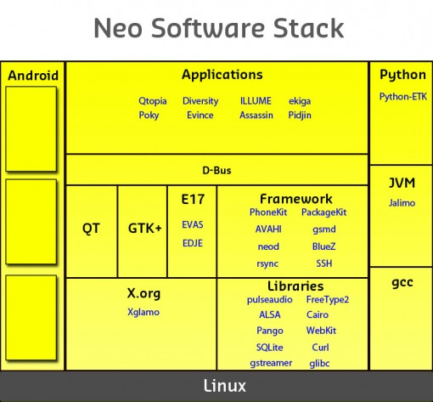

Slide 15
More Mobile Architectures
Access Mobile Architecture
LiPS Linux Mobile Architecture
LiMO Linux Foundation’s Architecture
Azingo Mobile Architecture
Qtopia Architecture
Maemo Architecture
LiMO cloning Azingo’ Architecture
JavaFX

Slide 16
Limitations of Mobile Computing
Power consumption
When a power outlet or portable generator is not available, mobile computers must rely entirely on battery power. Combined with the compact size of many mobile devices, this often means unusually expensive batteries must be used to obtain the necessary battery life.
Insufficient bandwidth
Mobile internet access is generally slower than direct cable connections, using technologies such as GPRS and EDGE, and more recently 3G networks. These networks are usually available within range of commercial cell phone towers. Higher speed wireless LANs are inexpensive, but have very limited range.
Security standards
When working mobile one is dependent on public networks, requiring careful use of VPNs.
Transmission interferences
Weather, terrain, and the range from the nearest signal point can all interfere with signal reception. Reception in tunnels, some buildings, and rural areas is often poor.
Potential health hazards
More car accidents are related to drivers who were talking through a mobile device. Cell phones may interfere with sensitive medical devices. There are allegations that cell phone signals may cause health problems.
Human interface with device
Screens and keyboards tend to be small, which may make them harder to use. Alternate input methods such as speech or handwriting recognition require training.

Slide 17
Mobile/Portable Computing
Mobile computing is a generic term describing one's ability to use technology while moving, as opposed to portable computers, which are only practical for use while deployed in a stationary configuration.
Many types of mobile computers have been introduced since the 1990s, including the:
Wearable computer
Personal digital assistant/Enterprise digital assistant
Smartphone: a PDA with an integrated cellphone functionality. Current smartphones have a wide range of features and installable applications
Carputer : a computing device installed in an automobile. It operates as a wireless computer, sound system, GPS, and DVD player. Also contains word processing software and it's bluetooth compatible
Ultra-Mobile PC (UMPCs ): full-featured, PDA-sized computer running a general-purpose operating system
Internet tablets/ keyboardless tablet PCs
Fly Fusion Pentop computer is a computing device the size and shape of a pen. It functions as a writing utensil, MP3 player, language translator, digital storage device, and calculator.
All these are categories of portable computing devices that can run on batteries but are not usually classified as laptops.

Slide 18
Mobile Computing Facts
"Mobile phones have evolved to become broadband-enabled multi-media devices that connect mass markets in mature and emerging markets alike, said Michael O'Hara, Chief Marketing Officer of GSM Association, Copyright 2009 © mJob -6-GSMA
In 2023, including both smart and feature phones, the current number of mobile phone users is 7.33 billion, which makes 91.53% of people in the world cell phone owners. Feature phones are the basic cell phones without apps and complex OS systems, more prominent in developing countries. (Source: https://www.bankmycell.com/blog/how-many-phones-are-in-the-world)
Mobile Web usage is increasing at a rate of 30 percent annually. Because this rapid growth creates opportunities for Internet-based companies to reach their customers in ways never imagined, designers are on board to create mobile friendly viewing which is considered one of the major disadvantages of using mobile devices.
According to Statista, the current number of smartphone users in the world today is 6.6 billion, and this means 44.81% of the world’s population owns a smartphone. This figure is up considerably from 2016 when there was only 2.5 billion users, 33.58% of that year’s global population. (Source: https://www.bankmycell.com/blog/how-many-phones-are-in-the-world)

Slide 19
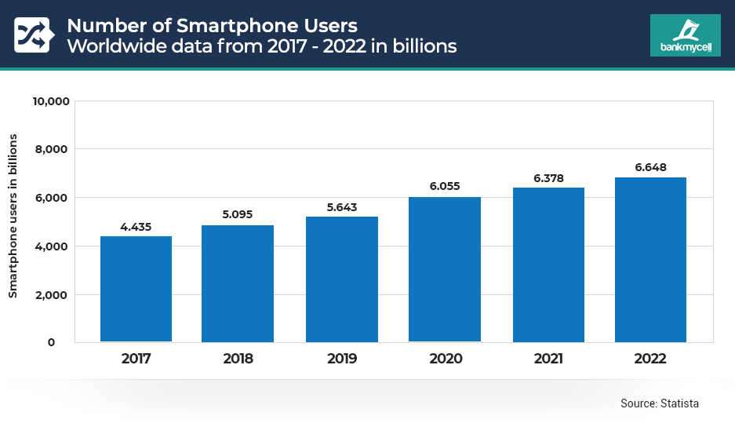

Slide 20
